Slide 1
Multi-Material
Stewardship Western
Draft Program Plan Consultation
July 10, 2023

Slide 2
Welcome

Slide 3
Introductions
Brenda Wallace – Principal, Wallace Insights
Kelly Goyer – Director of Field Services, MMSW
Ann Danilevich – Manager of Stakeholder Relations, Western Canada
Tamara Burns – Executive Director, Western Canada
Sam Baker – Acting VP, Operations, Western Canada
Lyndsey Chauhan – Director, Marketing Communications, Western Canada
Baljit Lalli - Chief Communications Officer, Circular Materials

Slide 4
Agenda
Draft Program Plan Review
Question & Answer Period
Discussion &
Feedback Activities
Consultation Next Steps
Background & Context

Slide 5
Background & Context

Slide 6

Who We Are
Established in 2013 as a non-profit organization.
Formed to develop and implement a product management program for household waste packaging and paper.
In response to the Province of Saskatchewan’s Household Packaging and Paper Stewardship Program Regulations.
Notes:
MMSW was established in 2013 as the producer responsibility organization (PRO) for the management of household waste packaging and paper product (WPP)

Slide 7
Overview
2016
540+
75%
500+
MMSW program launch
Producers participate in the program
Payment of net municipal costs by producers
Municipalities, First Nations communities & Regional Waste Authorities

Slide 8



Highlights
Since program launch in 2016 until end of 2022:
84%
285,115
72.9 M
Access
Tonnes collected
Payments by producers

Slide 9
Updated Regulation

Slide 10
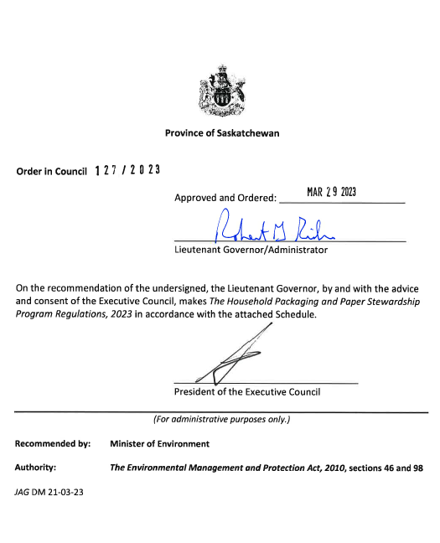
Updated Regulations
The Province of Saskatchewan conducted a review and engagement process (2021) on the existing regulation.
The Household Packaging and Paper Stewardship Program Regulations, 2023 (the Regulation) came into effect on March 31, 2023.
The Regulation calls for a transition to a full Extended Producer Responsibility (EPR) program for the management of household packaging and paper products (PPP) in SK.
These regulatory changes will result in a shift to a program fully funded and operated by producers of PPP.

Slide 11
Extended Producer Responsibility
Extended Producer Responsibility (EPR)
An approach to product stewardship where producers assume responsibility for the post-consumer management of a product. This can include partial or full financial and operational responsibility.

Slide 12

Ministry Principles For Plan Development
Preserve the integrity of residential recycling while ensuring uninterrupted collection service to residents.
Minimize disruption of existing municipal contracts with third parties.
Standardize the list of accepted materials.
Ensure an open and competitive market for future collection and processing of materials.
Outline a process for establishing standards, definitions, and service responsibilities.
Provide for continuous improvement of environmental outcomes.

Slide 13
National Integration

Slide 14

National Integration
MMSW is working with the national, not-for-profit producer led PRO, Circular Materials, to provide Saskatchewan residents and producers with the benefits of a nationally integrated approach to recycling.
This approach is designed to provide residents with a high level of service and enable producers to meet the ambitious requirements outlined within the Regulation while focusing on productivity gains that come with national integration.

Slide 15
About Circular Materials
National not-for-profit organization created and governed by producers.
  Supports producers in meeting obligations under extended producer responsibility (EPR) regulations.
Building efficient and effective recycling systems to:
  Advance innovation.
  Increase performance.
  Deliver improved environmental outcomes.
CM is designing recycling supply chains where materials are collected, recycled and returned to producers for use as recycled content in new products and packaging.
  This enhanced, closed-loop system will ensure materials are reused again and again.

Slide 16
Draft Program Plan Overview

Slide 17
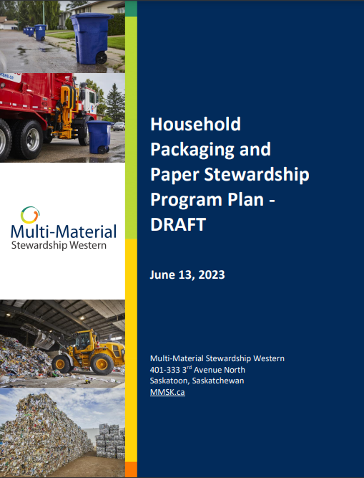
MMSW Program Plan
The Draft Program Plan outlines:
Objectives
Commitments
Transition phases
Roadmap to the transition from a shared responsibility model to a system that is managed and operated on behalf of its producer members.
Must be submitted to Ministry by September 27, 2023.
Notes:
Stress that timeline is dictated by the Regulation and that the compressed consultation process reflects the regulatory timeline (and is outside of MMSW’s control).

Slide 18
Producer Responsibility Organization (PRO)
MMSW administers Program Plan on behalf of producer members.
Composed of Saskatchewan and Western Canada-based team members.
Board of Directors:
  Charged with the responsibility of acting as fiduciaries for MMSW
  Composition on MMSW website
Circular Materials:
  National not-for-profit organization created and governed by producers
  Provides administrative support services to MMSW

Slide 19

Advisory Committee
Forum for stakeholders to be informed and provide advice/feedback.
Members reflect interests of:
  Urban and rural municipalities
  Regional waste management authorities
  Producer members
Program Plan outlines how members are selected.
Service providers under a transition phase will not be able to participate in the advisory committee moving forward.

Slide 20

Producer Membership
MMSW acts on behalf of producers that have signed a membership agreement.
Producers for PPP will be considered in accordance with the Regulatory hierarchy:
  Brand Owner, if resident in Canada
  First importer
  Retailer
Notes:
(a) If a business or organization supplies packaging to consumers in Saskatchewan and is the brand owner resident in Canada, that business is the obligated producer as the brand holder.
(b) If a business or organization is resident in Saskatchewan and imports packaging for which there is no brand holder resident in Canada, that business is the obligated producer as the importer.
(c) If these two situations do not apply, then the obligated producer is the retailer.

Slide 21

Program Financing
Producer members pay fees based on weight of PPP supplied to SK.
Fees are designed to cover:
  Material management
  Contribution to advance material management of applicable materials
  Resident awareness
  Program management
Cost allocation principles:
  All materials bear costs, irrespective if collected
  Costs applied to materials reflect their impacts to cost of managing system
  Commodity revenue applied only to materials that earn revenue

Slide 22
Materials Included
Packaging
  Glass
  Metal
  Paper
  Boxboard
  Cardboard
  Plastic
  Biobased plastic
  Any combination of these materials
Packaging-Like Products
  Paper gift and lunch bags
  Cardboard moving/filing boxes
  Plastics food storage containers
  Aluminum foil wrap
Paper Products
  Flyers
  Brochures
  Booklets
  Catalogues
  Telephone directories
  Newspapers
  Magazines
  Paper used for copying, writing or any other general use
Residential/household sources only

Slide 23
Program Design and Phases

Slide 24

Supply Chain Design Principles
Focus on outcomes, not process.
Provincial accessibility.
Provide economic incentives and set simple rules.
Foster interaction, collaboration and competition to drive innovation.
Set the stage for evolution.
Notes:
Focus on outcomes, not process – maximize recovery, program efficiency and system effectiveness;
Provincial accessibility – provide fair, reasonable, efficient and effective levels of collection service to all regions of Saskatchewan;
Provide economic incentives and set simple rules – effective economic incentives will drive behaviour that increases recovery activity throughout the PPP reverse supply-chain; simple rules will provide clarity and certainty to those collecting and recycling PPP;
Foster interaction, collaboration and competition to drive innovation – innovation is the result of complex interactions of ideas and efforts among producers and private, public and not-for-profit entities with parties bringing together complimentary skills to collaborate and deliver more value; and
Set the stage for evolution – harness existing activities and build on success through continuous improvement and use of economic incentives to increase collection of PPP and improve system efficiency.

Slide 25



Accepted Materials
List of accepted materials differs across programs and processing facilities.
MMSW must procure processing capacity before accepted material list can be confirmed.
Detailed accepted material list to be developed during design phase of each transition phase.
Goal is to expand and harmonize list across all collectors in each transition phase.

Slide 26

Accepted Materials
Targeted for Phase 1 & 2:
  Paper and cardboard
  Mixed containers
Targeted for Phase 3:
  Flexible plastics
  Foam packaging
  Glass bottles and jars

Slide 27
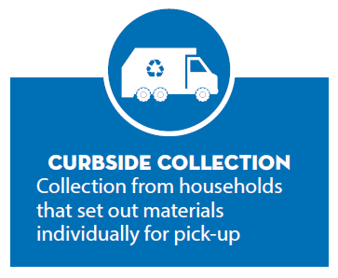
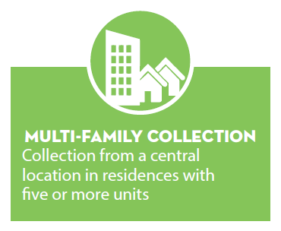
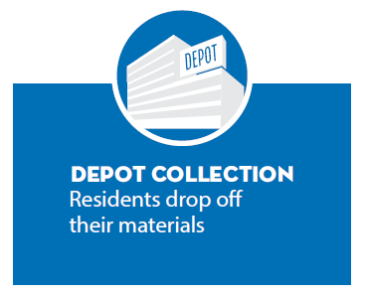
Collection System
MMSW will contract with collection service providers which meet MMSW’s collection qualification standards and policies/procedures.

Slide 28

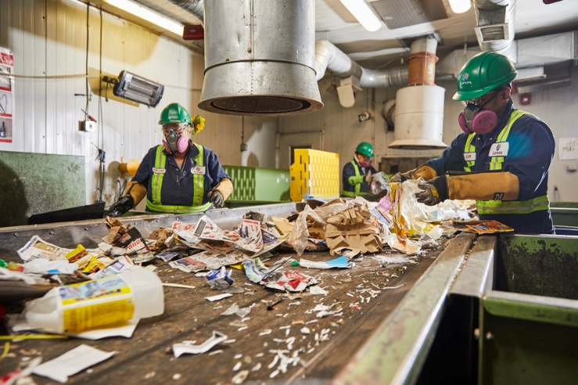
Post-Collection System
MMSW will be responsible for all aspects of post-collection for PPP collected under each transition phase, including:
  Receiving
  Processing
  Marketing
MMSW priority when selecting end-markets:
  Local markets
  Regional markets
  OECD countries

Slide 29
Phased Approach To Implementation
Phase 1
Design
Phase 2
Design
Phase 3
Implementation
Procurement
Procurement
Implementation
Design
Procurement
Implementation

Slide 30
Transition Phase 1 – Curbside & Multi-Family
Design:
  Compile information from MMSW collectors and complete markets analysis
  Develop collection policies and procedures, collection agreements and incentive rates
  Design catchment area(s) and eligible communities
  Develop procurement process and documents
  Finalize curbside/multi-family accepted material list
Procurement:
  Competitive procurement process for post-collection services
  Release of collection agreements and incentive rates to eligible communities
Implementation:
  Launch of curbside/multi-family collection with applicable communities
Notes:
Emphasize targeting of logical post-collection flows from one or more clusters of large communities with existing curbside and multi-family PPP programs participating in the MMSW program.

Slide 31
Transition Phase 2 – Curbside & Multi-Family
Design:
  Develop and consult on Curbside and Multi-Family Collection Eligibility Criteria
  Develop procurement process for eligible curbside and multi-family communities
  Design catchment areas, collection agreements and incentive rates
  Apply changes to accepted material list, as applicable
Procurement:
  Competitive procurement process for post-collection services
  Competitive procurement process for collection services, as applicable
  Release of collection agreements and incentive rates to eligible communities as applicable
Implementation:
  Launch of curbside/multi-family collection with applicable communities

Slide 32
Transition Phase 3 – Depot
Design:
  Develop and consult on Depot Collection Eligibility Criteria
  Complete cost study on all collection channels and develop depot incentive rates
  Complete assessment on option of MMSW providing curbside/multi-family collection directly in applicable communities
  Develop procurement process and documents
  Finalize depot accepted material list
Procurement:
  Competitive procurement process for post-collection services
  Release of collection agreements and incentive rates to depot collectors
Implementation:
  Launch of depot collection
  Application of updated curbside/multi-family incentive rates

Slide 33

Approach To Incentives
As MMSW last conducted a cost study in 2022, the study’s data will be used to guide the curbside and multi-family incentive rates for Phase 1 and 2.
During the design stage of Phase 3, MMSW will conduct a cost study to develop depot incentive rates and to update the curbside and multi-family incentive rates in the current market context.
Once new collection service agreements have been offered to eligible collectors, inclusive of the new financial incentives, each applicable collector must then decide whether to move forward in a service agreement with MMSW.
Notes:
Designed with sufficient incentive to collect the amount of PPP required by MMSW to meet its targets and to cover fair and reasonable collection costs borne by contracted collectors operating efficient programs.
As the roles and responsibilities of collection service providers under Transition Phase 1 and 2 will differ from the services provided under current service agreements (e.g., collection service providers will no longer be required to procure post-collection services), the incentive rates offered will reflect this new outcome.
As in past years, MMSW will work with the Advisory Committee in determining its approach to these studies.

Slide 34

Non-Transitioned Collectors
MMSW collectors will continue to receive payments in accordance with the terms of their existing agreements until:
  An offer is accepted for collection services in accordance with one of the transition phases
  Another organization has established a collection services agreement with MMSW to provide curbside, multi-family and/or depot collection services in the applicable community
  All transition phases are completed (one year after Phase 3 Implementation)

Slide 35
Transition Phases - Timeline
Phase 1
Latter of:
Phase 2
Phase 1 + 1 year
Phase 3
Phase 2 + 1 year
6 months after plan approval
July 1, 2024

Slide 36
Resident Communications
MMSW will design and deliver an effective resident education program that supports achieving program targets by focusing on two primary objectives:
  Increase resident awareness of the program features and benefits
  Engage and encourage residents to participate in the program and make informed and correct decisions concerning the preparation and management of PPP
Communities acting as collection service providers will retain primary responsibility for delivering resident communication strategies associated with the collection of PPP.
MMSW will employ education and awareness campaigns, develop collector resources, provide resident support services and conduct research.

Slide 37
Program Performance

Slide 38

Waste Management Hierarchy
MMSW will seek to manage PPP in accordance with the Waste Management Hierarchy:
  Reduce the environmental impact of producing the product by eliminating toxic components and increasing energy and resource efficiency
  Redesign the product to improve reusability or recyclability
  Eliminate or reduce the generation of unused portions of a product that is consumable
  Reuse the product
  Recycle the product
  Recover material from the product
  Recovery energy from the product
  Dispose of the waste from the product

Slide 39

Performance Targets
During the transition phases, MMSW will seek to maintain an overall program collection rate of 72.5%.
Upon completion of Phase 3, MMSW will propose and consult on targets for:
  Overall program recycling rate
  Overall program diversion rate
  Recycling rate by PPP category
  Diversion rate by PPP category

Slide 40

Consultation Process
In-person sessions:
  Regina - June 27
  Saskatoon - June 28
Virtual sessions:
  Producers and Producer Associations - July 4
  Local Governments and Communities - July 5
  Waste Management Companies - July 5
  All Stakeholder Groups - July 10
Feedback can be submitted in writing until August 13 via email to info@multimaterialsw.ca.

Slide 41
Thank You

